Slide 1
BRIEF ACCOUNT OF LUNGS
IN VERTEBRATES
BY
JAVIED IQBAL
(ASSISTANT PROFESSOR)
DEPT. OF ZOOLOGY,
GOVT. P. G. COLLEGE,
RAJOURI

Slide 2
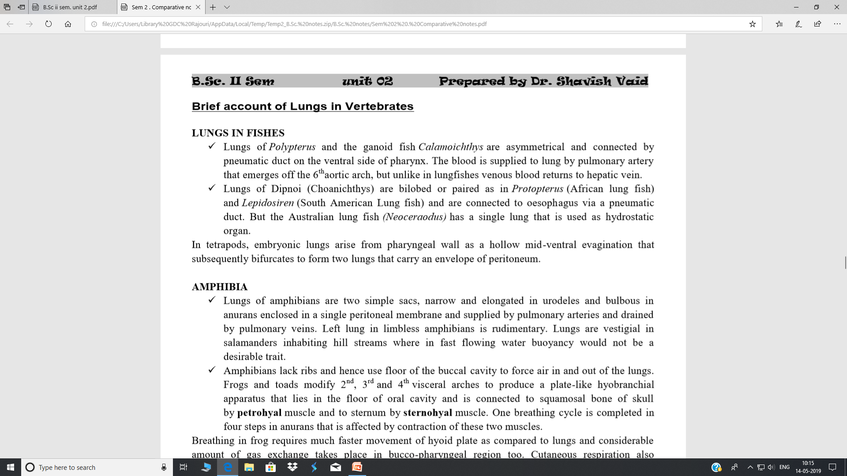

Slide 3
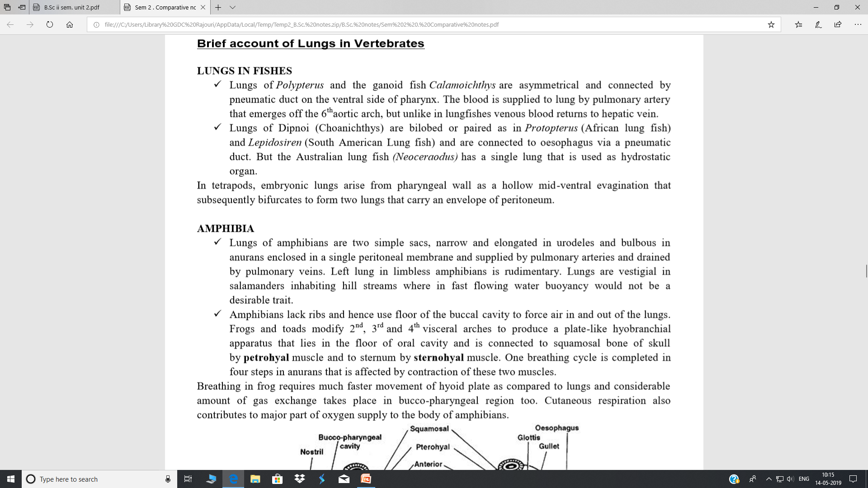

Slide 4
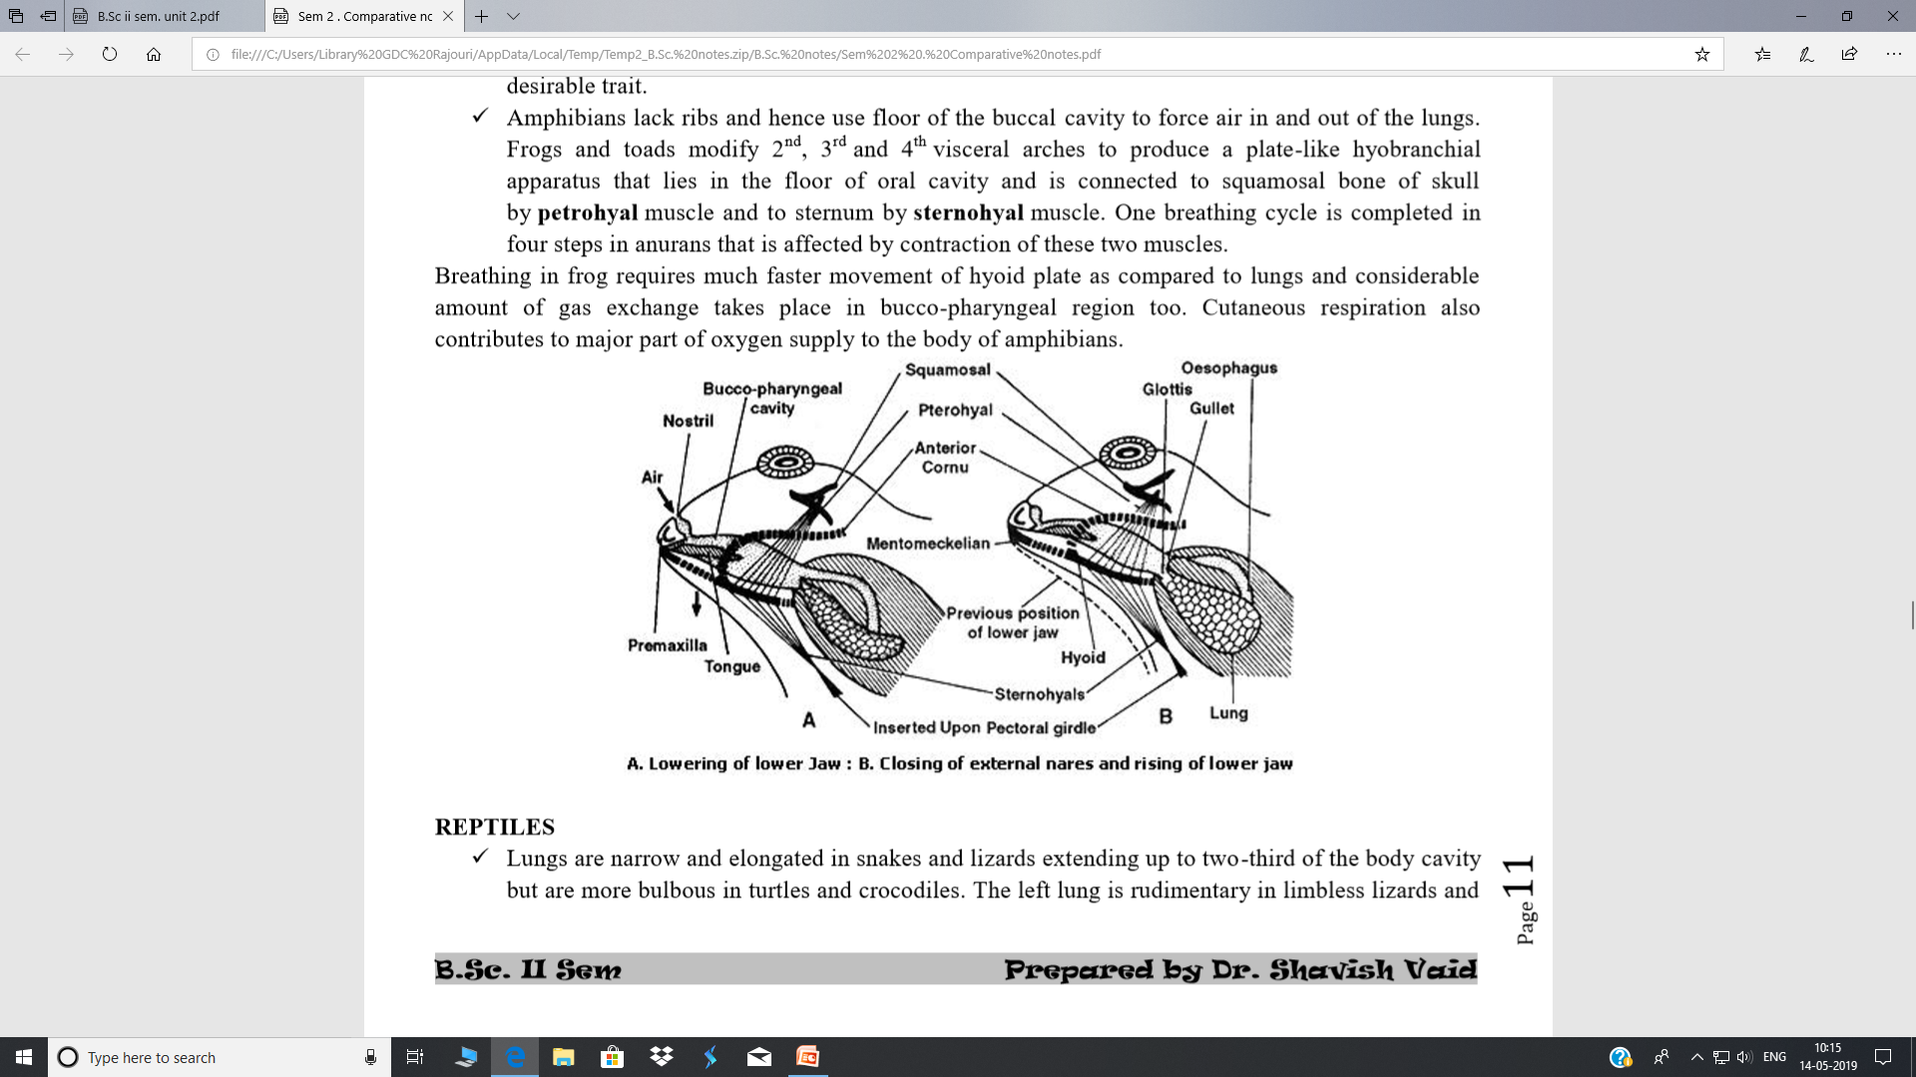

Slide 5
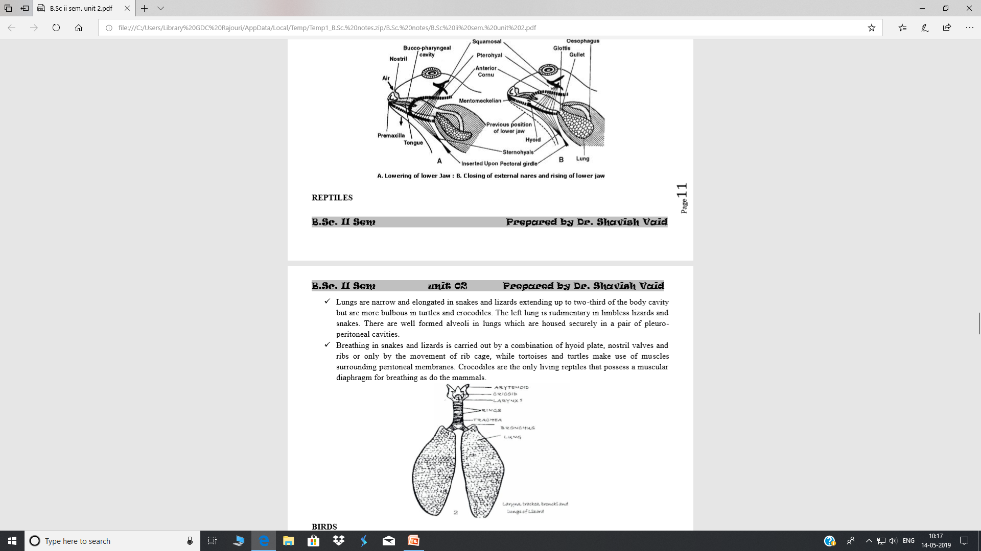
Reptiles

Slide 6
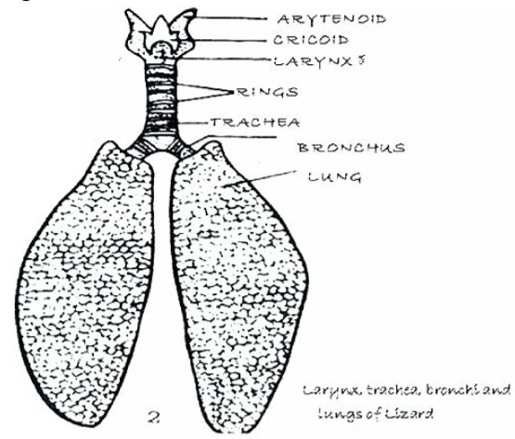

Slide 7
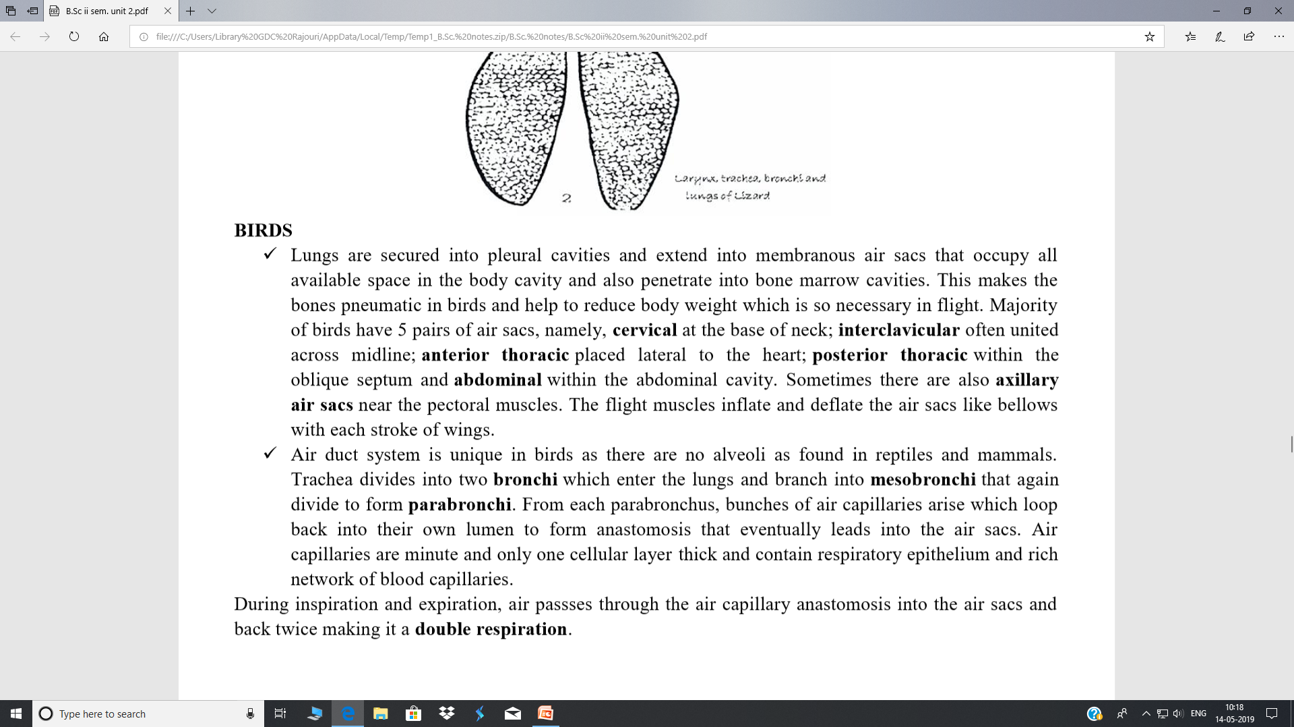

Slide 8
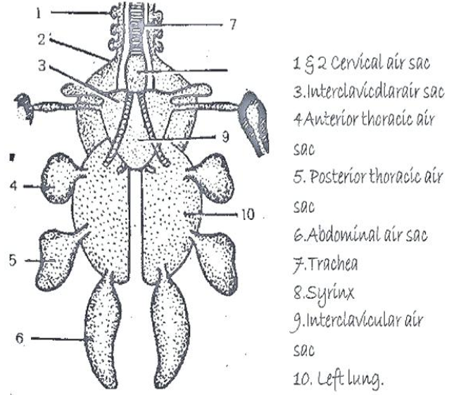

Slide 9
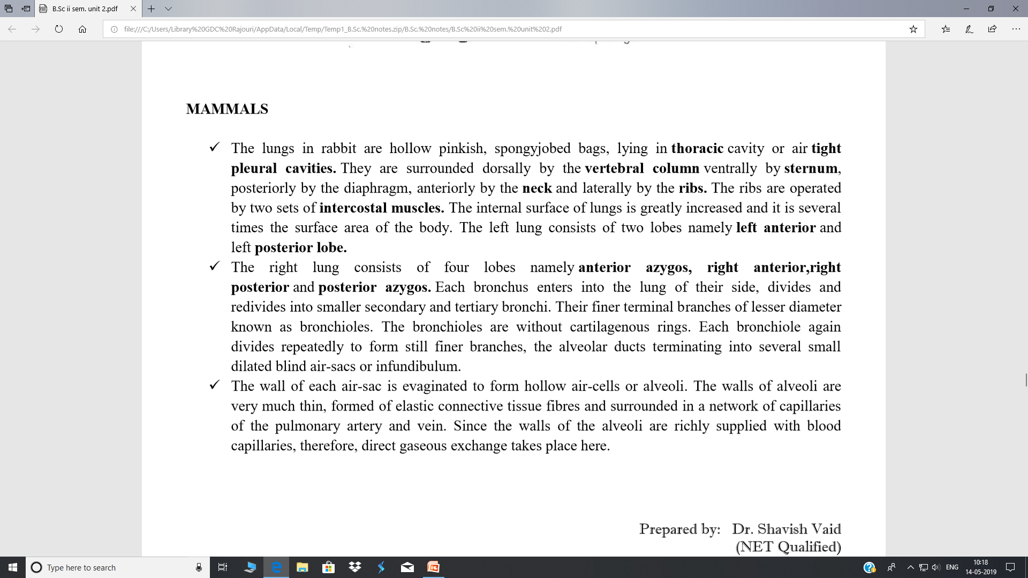

Slide 10
